Slide 1
Beyond Big Brother: A Proactive Approach to Online Course Evaluation
Kelly Winchell, josh Ruggiero, sherri strobel, dr. sherry scanlon

Slide 2
WELCOME
Sheryl Scanlon, Ed.D.
Sherri Strobel, M.Ed., DCC
Ed.D. Argosy University
M.S. Wilmington University
B.S. Neumann University
25+ years in business
12 years teaching at WU
M.Ed. Wilmington University
B.A. Elizabethtown College
Distance Credentialed Counselor certification
School Counseling Certification in NJ
Academic Advisor at WU for 5 years
3 years teaching at WU
Kelly Winchell, M.Ed.
Josh Ruggiero, M.S.
M.Ed Wilmington University
B.S. Wilmington University
7+ years as an Instructional Designer
8 years teaching elementary school
1 year teaching at WU
M.S. Delaware State University
B.S. Wilmington University
5 years Admissions/Athletic Associate at WU
9 years as College Coach
8 years teaching at WU

Slide 3
Who is Wilmington University
“Everyone should have the opportunity to earn a college education”
- Dr. Jack Varsalona
Wilmington University President

Slide 4
Who is Wilmington University
Private, Non-Profit
Fully Accredited by Middle States Commission on Higher Education
Career Oriented Programs
Undergraduate, Graduate and Doctorate
1,601 Faculty trained to teach Online Courses (2,259 active faculty overall)

Slide 5
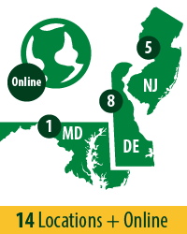
Who is Wilmington University

Slide 6
Wilmington University Online
Top 10 Best Online Colleges 2015 according to BestCollegeReviews.org
Multiple Blackboard Exemplary Courses Designed
Ranked #2 “Technologically Savvy” Schools in 2014 according to OnlineSchoolsCenter.com
2014 ranked 3rd fastest growing nonprofit university in America 2015 by The Chronicle of Higher Education.

Slide 7
What Online Learning Means to WilmU
Since 2011
218%
359%
Online Learning Enrollment
Students Enrolled 100% Online

Slide 8
Online Coordinator Role
Course Evaluations
(Quality)

Slide 9
Teaching Expectations Guide
Defines and articulates the expectations for all Wilmington University instructors
Expectations are based on best practices in Online Learning
Document created by the Office of Academic Affairs at Wilmington University
Distributed to the faculty and available on our website

Slide 11
Observations of Online Courses
Announcements
Syllabus/Faculty Contact Information
Grade Center
Videos = Kaltura/Collaborate Sessions
Feedback
Reviews provide a “snapshot” of each course. (Before the start of course / midpoint / weekly – structured to meet the needs of the Chair)
High Tech / High Touch

Slide 12
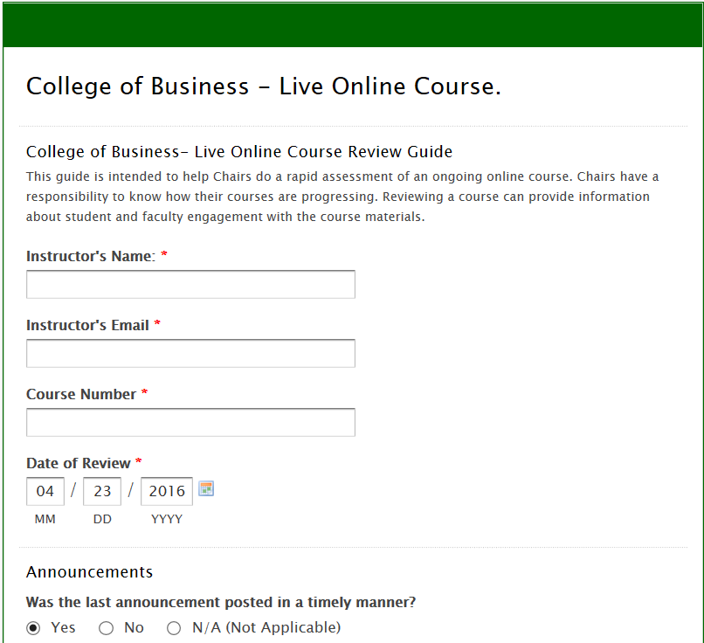
Link to Wufoo Form

Slide 13
How do we use this information?
College of Business
Report emailed to instructor and Chair
College of Health Professions
Email to the Chair
College of Arts and Sciences
Personal email to instructor
College of Social and Behavioral Sciences
Personal email to instructor
Email to chair if necessary.
Email to chair if necessary.

Slide 14
Additional Responsibilities
Course Evaluations
(Quality)
Mentoring
Chairs
Online
Coordinator
Course Development
New Hires
Adjuncts

Slide 15
TechTools used by Online Coordinators

Slide 16
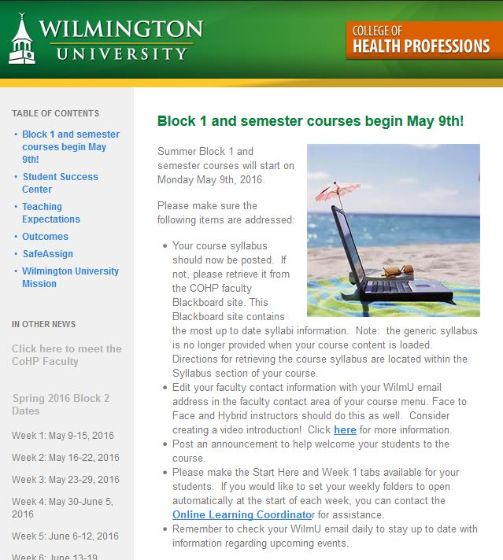

Slide 17
Video Tools

Slide 18
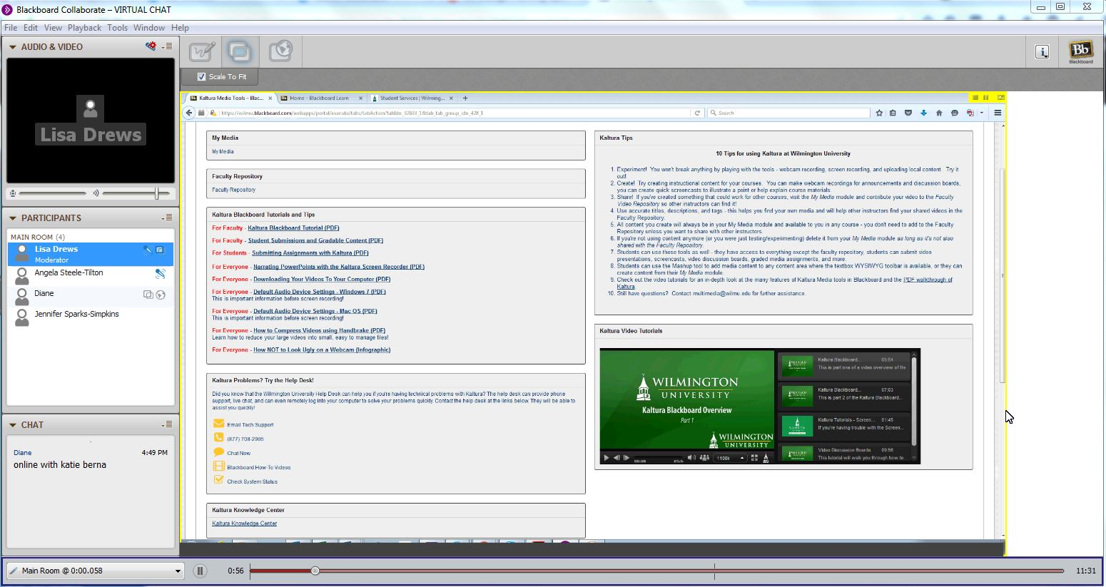
Blackboard Collaborate

Slide 19
Our Purpose
Supporting our Adjunct Instructors
Ensuring Quality Courses for our Students

Slide 20
Supporting our Adjunct Instructors
We Contact Instructors
Course Observations
New OL Instructors
Instructors Contact Us
Questions
Navigation

Slide 21
Supporting our Adjunct Instructors
Proactive
Course Evaluations
Reactive
Instructor Questions
Strong Relationship
Instructors feel confident and supported by the University
New OL Instructor Support
Navigation Assistance

Slide 22
Ensuring Quality Courses for our Students
Instructor and Course Expectations
Student Responsibilities
Consistency

